Slide 1
ECE4321 Computer Networks
Chapter 7
HDLC

Slide 2
Data Link Control Protocols
Advance Data Communication Control Procedures (ADCCP): ANSI X3.66 adopted by the US National Bureau of Standards (FIPS PUB 71-1)
Link access procedure balanced (LAP-B): adopted by CCITT, a part of x.25
Synchronous data link control (SDLC): IBM
High level data link control (HDLC): most widely used

Slide 3
High Level Data Link Control
HDLC
ISO 33009, ISO 4335
Most widely used DLC protocol

Slide 4
HDLC Station Types
Primary station
  Controls operation of link
  Issues commands (frames)
  Maintains separate logical link to each secondary station
Secondary station
  Under control of primary station
  Issues responses (frames)
Combined station
  May issue commands and responses
  Combines the features of primary and secondary stations

Slide 5
HDLC Link Configurations
Unbalanced
  One primary and one or more secondary stations
  Supports full duplex and half duplex
Balanced
  Two combined stations
  Supports full duplex and half duplex

Slide 6
HDLC Transfer Modes (1)
Normal Response Mode (NRM)
  Unbalanced configuration
  Primary can only initiate transmission
  Secondary may only transmit data in response to command (poll) from primary
  Used on multi-drop lines
  Host computer as primary
  Terminals as secondary

Slide 7
HDLC Transfer Modes (2)
Asynchronous Balanced Mode (ABM)
  Balanced configuration
  Either station may initiate transmission without receiving permission
  Most widely used
  No polling overhead

Slide 8
HDLC Transfer Modes (3)
Asynchronous Response Mode (ARM)
  Unbalanced configuration
  Secondary may initiate transmission without permission form primary
  Primary is responsible for connect, disconnect, error recovery, and initialization
  rarely used

Slide 9
Frame Structure
Synchronous transmission
All transmissions in frames
Single frame format for all data and control exchanges

Slide 10
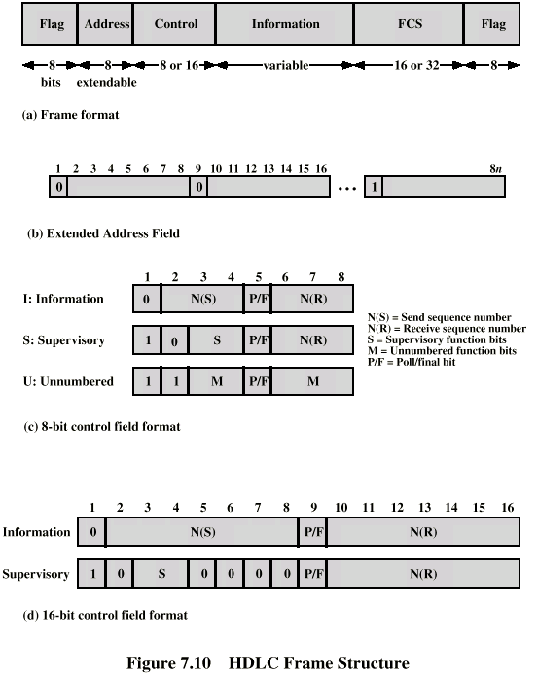
Frame Structure
Defines 3 types of frames (I,S,U frames)
01111110
01111110

Slide 11
Flag Fields
Delimit frame at both ends
01111110
Receiver hunts for flag sequence to synchronize
Bit stuffing used to avoid confusion with data containing 01111110
  The transmitter inserts 0 bit after every sequence of five 1s with the exception of flag fields
  If receiver detects five 1s it checks next bit
    If 0, it is deleted
    If 1 and seventh bit is 0 (i.e., 10), accept as flag
    If sixth and seventh bits 1 (i.e., 11), sender is indicating abort

Slide 12
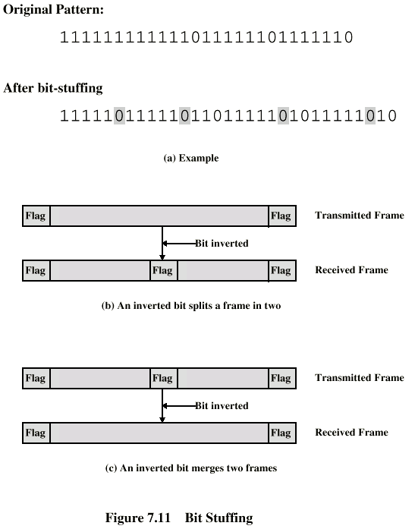
Bit Stuffing
Example with
possible errors

Slide 13
Address Field
Identifies secondary station that sent or will receive frame
Usually 8 bits long
May be extended to multiples of 7 bits
  LSB of each octet indicates that it is the last octet (1) or not (0)
All ones (11111111) is broadcast

Slide 14
Control Field
Different for different frame type
  I-frame (information frame)
    data to be transmitted to user (next layer up)
    Flow and error control piggybacked on information frames
  S-frame (Supervisory frame)
    Used for flow and error control
  U-frame (Unnumbered frame)
    supplementary link control
First one or two bits of control filed identify frame type

Slide 15
Control Field Diagram

Slide 16
Poll/Final Bit
Use depends on context
Command frame
  P bit : used for poll from primary
  1 to solicit (poll) response from peer
Response frame
  F bit : used for response from secondary
  1 indicates response to soliciting command

Slide 17
I-frame
Contains the sequence number of transmitted frames and a piggybacked ACK
1 2 3 4 5 6 7 8
0
N(S)
P/F
N(R)
I,0,0
I,1,0
I,2,0,P

Slide 18
S-frame
Used for flow and error control
1 2 3 4 5 6 7 8
1
0
S
P/F
N(R)
RR --- receive ready
RNR --- receive not ready
REJ --- reject on frame N(R)
SREJ --- selective reject on N(R)

Slide 19
U-frame
Mode setting, recovery, connect/diconnect
1 2 3 4 5 6 7 8
1
1
M
P/F
M
Unnumbered function bits

Slide 20
Unnumberred frames
Set normal response mode (SNRM)
Set asynchronous response mode (SARM)
Set asynchronous balanced mode (SABM)
Disconnect (DISC)
Unnumberred acknowledgement (UA)
Disconnect mode (DM)
Request disconnect (RD)
Unnumberred poll (UP)
Reset (RSET)
Exchange identification (XID)
Test (TEST)
Frame reject (FRMR)

Slide 21
Information Field
Only in information and some unnumbered frames
Must contain integral number of octets
Variable length

Slide 22
Frame Check Sequence Field
FCS
Error detection
16 bit CRC
Optional 32 bit CRC

Slide 23
HDLC Operation
Exchange of information, supervisory and unnumbered frames
Three phases
  Initialization
  Data transfer
  Disconnect

Slide 24
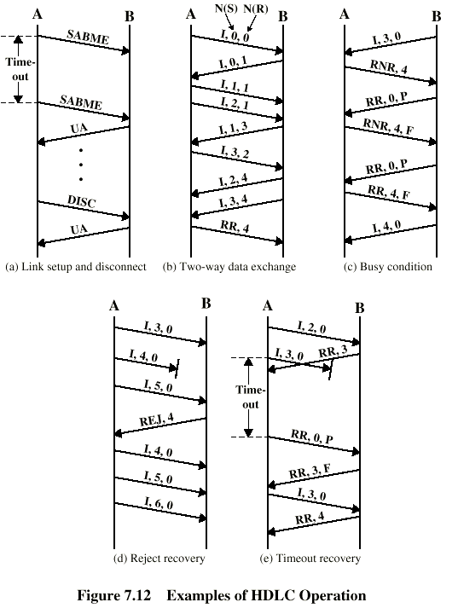
Examples of Operation (1)

Slide 25
Examples of Operation (2)

